Slide 1


Acoustic scene classification
Cognitive Computing and Artificial Intelligence 2024
University of Catania, Italy
2023-2024

Slide 2
Team
Aldo Barca 1000050457
Francesco Cerruto 1000005927
Giovanni Traina
1000053629

Slide 3
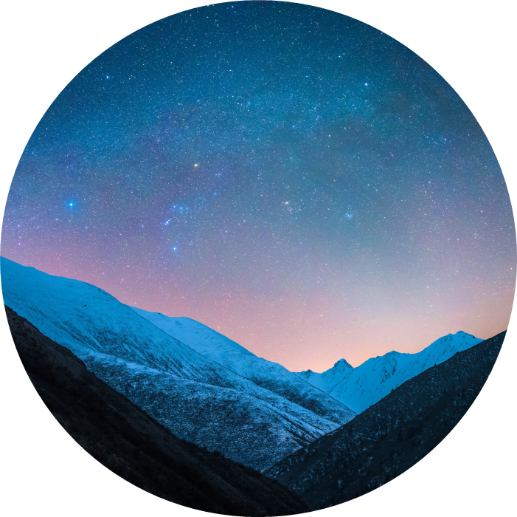
Introduction
Acoustic scene classification is an important task based on recognizing given an audio, in which type of environment the audio was taken of. The difficulty of the task is based on the noisy environment and the variability of sounds which every environment can have.
Moreover, gathering lots of data is really hard, considering the privacy laws, so it’s really hard to have considerable datasets.

Slide 4
Task specification
The key points of the project are:
Train a network using fine-tuning
Use TUT 17 Dataset
Perform training 3 times, varying the portion of usable data of the dataset (100%, 50% and 10%)
Test the network created trying to have good results

Slide 5
Our key ideas
We choose to use Audio Spectrogram Transformer (AST) pre-trained on AudioSet. AST can be easily synthetized as the equivalent of ViT for Audio instead of Images. As a transformer, a state of art architecture, it can grant great performances. In particular when there is temporal (in an audio scenario) correlation or sequential correlation (in a speech scenario). This particularity is thanks to its core difference from other architectures, the attention.
Use data augmentation for audio to improve generalization, reducing overfitting and even make model more resilient to variation and noises in inference. The data augmentation is not done to increase the dataset size, considering the already polished version we used.
Lastly we decided to use to evaluate model performances under three scenarious, pure fine-tuning, shallow prompt-tuning and deep prompt-tuning.

Slide 6
TUT 17
The dataset used by our model is TUT 17 development set. It’s composed by 4680 audio of 15 different acoustic scenes. Every audio is exactly 10s, therefore there is no different duration audio problem (really dangerous for Audio Processing Models).
The dataset has labels divided in 12 files, already divided in 4-folds. For each fold there is a file called foldn_train.txt, foldn_evaluate.txt and foldn_test.txt. Each file is written in a csv format and contains the audio name and the matching true acoustic scene of the audio (label).
We decided to use only train and evaluate files because evaluate and test files contains the same information minus the labels. We perform validation phase using a fraction of the train set data.
The fold-divided structure of the dataset is designed to let 4-folds cross-validation be easy to do. The dataset creator decided to use a 0.666 fraction of the audio for the train and the remaining 0.333 for the evaluation (test), for a total of 3510 audio for training and 1170 for testing.
Other than development dataset, used during the training phase, we used TUT 17 evaluation dataset to evaluate our models.

Slide 7
The model
AST, acronym of Audio Spectrogram Transformer, as the name suggest is a Transformer type model based on spectrogram inputs. Therefore it’s literally made for audio processing.
In our case we are taking the AST pre-trained model using the ASTModel class from the transformers library. The ASTModel class return us an AST pre-build and pre-trained model without the classification head (fully connected/ linear layer).
This allow us to fine tune the already pre-trained model on our task-specific dataset, creating and adding to the model a perfectly suitable task-oriented classifier head.

Slide 8
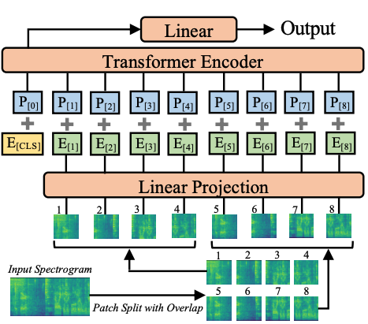
Given the spectrogram input, firstly it is given to a linear projection layer where features extracted from the spectrogram are turned into a higher dimensional space.
Then the input is passed on a positional encoding layer so that AST does a positional encoding of the spectrograms, so that it knows the position of the various features in the spectrogram.
Lastly the encoder, key component of a transformer model thanks to the attention mechanism, captures the different relationships between various part of the spectrogram. At the top of the architecture it’s used a classification layer for the classification task.
AST Architecture

Slide 9
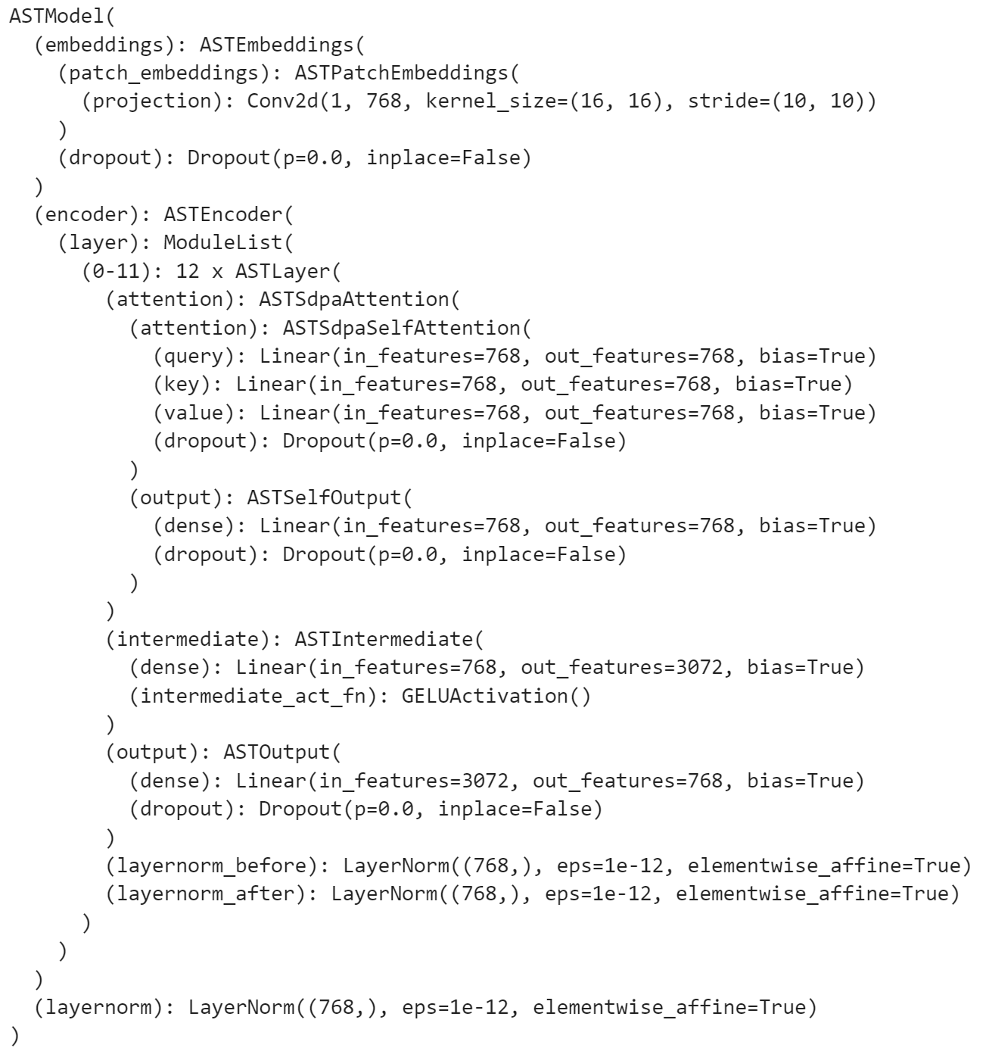
Notes:
Note: Si usa la GeLu, Gaussian Error Linear Unit come Funzione di attivazione in alcuni layer dell’encoder, rispetto alla classica ReLu la GeLu evita meglio l’overfitting e lavora meglio con valori negativi dei neuroni.

Slide 10
Data Pre-Processing
From a data pre-processing point of view we use the AST feature extractor from the class ASTFeatureExtractor.
Given an audio loaded by librosa we perform audio data augmentation, using the following transformations:
Shift time : Tecnique which creates new version of the audio, shifting the time. It helps avoiding overfitting thanks to the variation of the data. Moreover it helps handling delays and advances during inference phase.
shift = np.random.randint(len(audio) * 0.2
audio = np.roll(audio, shift)
Amplification: Amplify the audio to capture better sound with low amplitude.
ampl = 2.0
audio = audio * ampl

Slide 11
Fine-Tuning
The task needs a fine-tune on TUT 17 dataset. This is done using the pre-trained network and adding over it our classification layer. Then during training we do what’s called freezing. Freezing means keep the already pre-trained parameters of AST (pre-trained on AudioSet dataset) and then train only the parameters of the new added linear layers, the ones which will be tuned on our specific task.
From a pratical point of view, we added 2 linear layers that reduce the space dimensionality to 384 and 15 neurons respectively. The last dimension, 15 is of course our number of classes provided by the TUT 17 dataset.

Slide 12
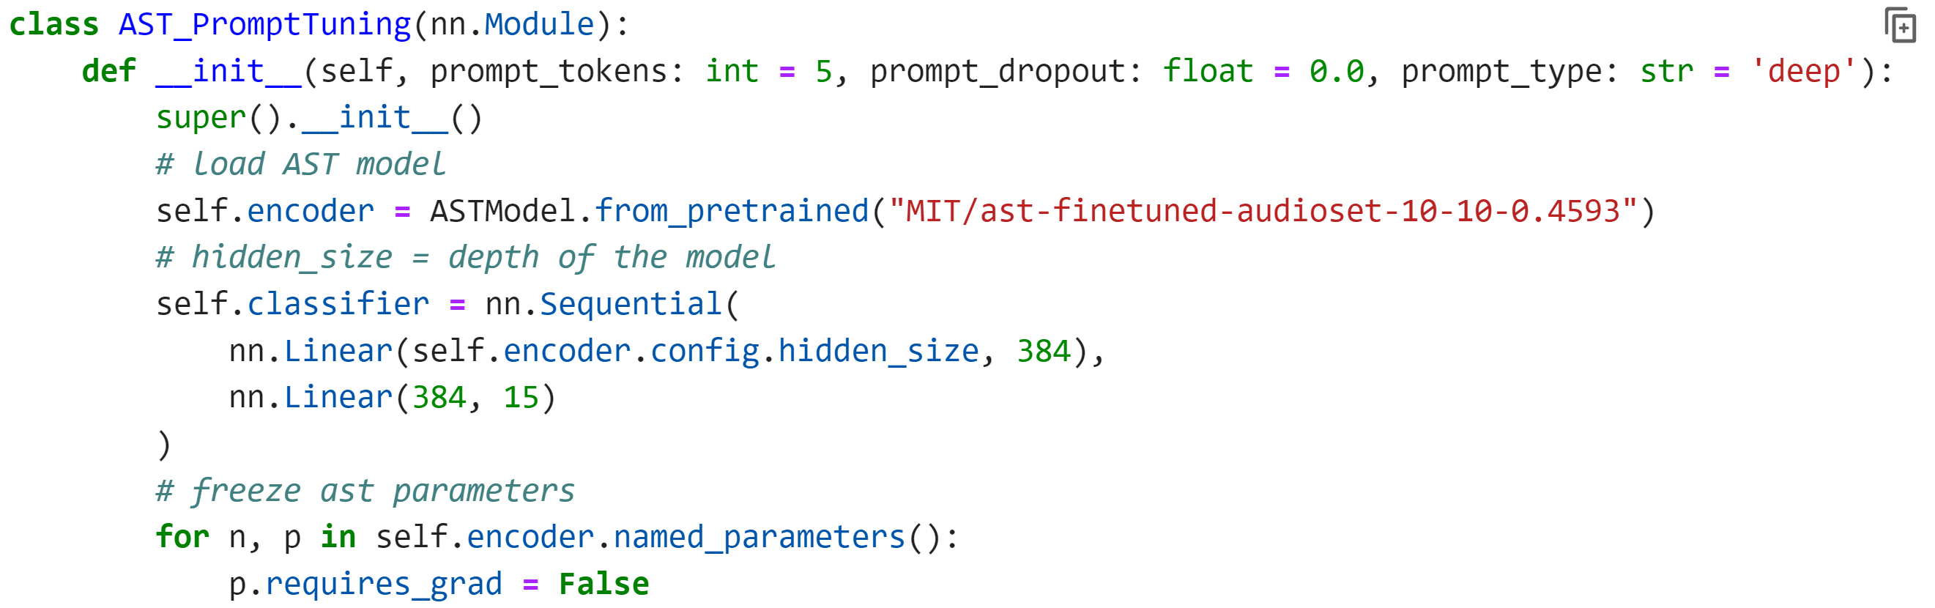
Note: THE class is called AST_Prompt-tuning, even so if the prompt_type is none is actually a pure fine-tuned network without prompt tuning

Slide 13
Prompt-Tuning
Other than fine-tuning, even if not requested, we decided to do the prompt tuning of model. The prompt tuning uses an additional set of parameters, called prompts.
Deep: Differents prompt for each layer.
Shallow: Only one prompt introduced at the first layer.

Slide 14
Training
Other than fine-tuning, even if not requested, we decided to do the prompt tuning of model. The prompt tuning uses an additional set of parameters, called prompts.
Deep: Differents prompt for each layer.
Shallow: Only one prompt introduced at the first layer.

Slide 15
Training
Other than fine-tuning, even if not requested, we decided to do the prompt tuning of model. The prompt tuning uses an additional set of parameters, called prompts.
Deep: Differents prompt for each layer.
Shallow: Only one prompt introduced at the first layer.

Slide 16
Training
Other than fine-tuning, even if not requested, we decided to do the prompt tuning of model. The prompt tuning uses an additional set of parameters, called prompts.
Deep: Differents prompt for each layer.
Shallow: Only one prompt introduced at the first layer.

Slide 17
Training
Other than fine-tuning, even if not requested, we decided to do the prompt tuning of model. The prompt tuning uses an additional set of parameters, called prompts.
Deep: Differents prompt for each layer.
Shallow: Only one prompt introduced at the first layer.

Slide 18
Chart

Slide 19
Table
 | Category 1 | Category 2 | Category 3 | Category 4
Item 1 | 4.5 | 2.3 | 1.7 | 5
Item 2 | 3.2 | 5.1 | 4.4 | 3
Item 3 | 2.1 | 1.7 | 2.5 | 2.8
Item 4 | 4.5 | 2.2 | 1.7 | 7

Slide 20

The way to get started is to quit talking and begin doing.
Walt Disney

Slide 21
Timeline
Title
To start a presentation, go to the Slide Show tab, and select From Beginning.
Title
To display Presenter view, in Slide Show view, on the control bar at the bottom left select the three dots, and then Show Presenter View.
Title
During your presentation, the speaker notes are visible on your monitor, but aren't visible to the audience.
Title
The Notes pane is a box that appears below each slide. Tap it to add notes.
Title
If you don’t see the Notes pane or it is completely minimized, click Notes on the task bar across the bottom of the PowerPoint window.

Slide 22
Title
Subtitle
Subtitle
Add text, images, art, and videos.
Add transitions, animations, and motion.
Save to OneDrive, to get to your presentations from your computer, tablet, or phone.
Open the Design Ideas pane for instant slide makeovers.
When we have design ideas, we’ll show them to you right there.

Slide 23
Title
Subtitle
Subtitle
Subtitle
Add text, images, art, and videos.
Add transitions, animations, and motion.
Save to OneDrive, to get to your presentations from your computer, tablet, or phone.
Open the Design Ideas pane for instant slide makeovers.
When we have design ideas, we’ll show them to you right there.
This PowerPoint theme uses its own unique set of colors, fonts, and effects to create the overall look and feel of these slides.
PowerPoint has tons of themes to give your presentation just the right personality.

Slide 24



Summary
With PowerPoint, you can create presentations and share your work with others, wherever they are. Type the text you want here to get started. You can also add images, art, and videos on this template. Save to OneDrive and access your presentations from your computer, tablet, or phone.

Slide 25



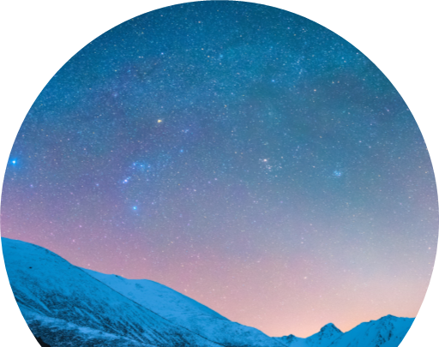
Thank you
Presenter name
Email address
Website

